Slide 1
Title: Interactive Sales & Financial Dashboard -
Presented by: Apeksha Guggarimath
Date: 25-09-2025

Slide 2
Introduction
This project focuses on designing an interactive dashboard using Power BI or Tableau to help business stakeholders make informed decisions based on sales and financial data. The primary objective is to transform raw data into meaningful visual insights by selecting key performance indicators such as total sales, profit, and growth trends. Using a dataset sourced from Kaggle, the dashboard incorporates features like time-series analysis, slicers for interactivity, and summary cards for quick reference. A consistent color theme ensures visual clarity, while optional navigation menus enhance user experience. The final deliverables include a fully functional dashboard and a PowerPoint summary that outlines the design process, key findings, and actionable insights. Through this task, the goal is to develop a data-driven storytelling approach that supports strategic planning and operational efficiency.

Slide 3
Objective
To design a dynamic The objective of this project is to design an interactive dashboard using Power BI or Tableau that empowers business stakeholders to make informed, data-driven decisions. By leveraging a Sales_Financial dataset sourced from Kaggle, the dashboard aims to visualize key performance indicators such as total sales, profit, growth trends, and customer segmentation. The goal is to simplify complex data into intuitive visuals that highlight patterns, outliers, and actionable insights. Features like time-series analysis, slicers for interactivity, and summary cards for quick reference are incorporated to enhance usability. A consistent color theme ensures clarity, while optional navigation menus provide a seamless user experience. Ultimately, this project helps bridge the gap between raw data and strategic decision-making, showcasing analytical and design skills through a professional dashboard and a concise presentation. dashboard that helps stakeholders monitor key business metrics and make informed decisions

Slide 4
Dashboard Features
Time-series analysis for trends
Cards for totals and summaries
Slicers/filters for interactivity (Region, Product, Time)
Consistent color theme for clarity

Slide 5
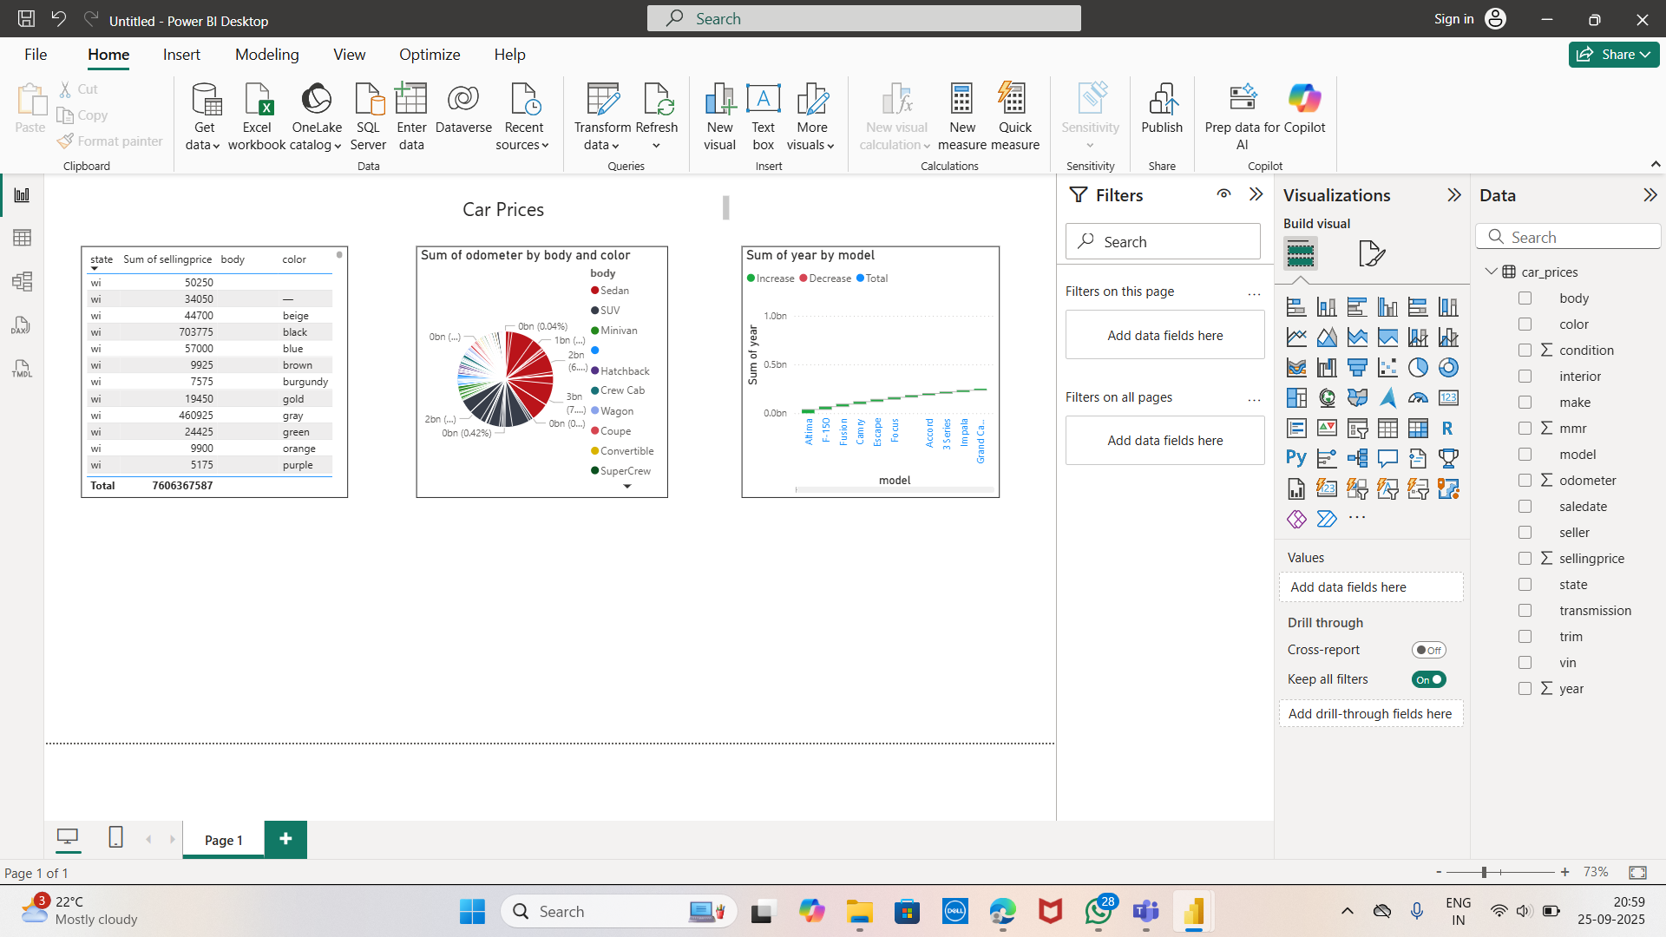
Dashboard Screenshots

Slide 6
conclusion
This dashboard design project has provided a comprehensive understanding of how to transform raw sales and financial data into meaningful visual insights using Power BI or Tableau. By selecting relevant KPIs, applying interactive features like slicers and filters, and incorporating time-series analysis, the dashboard effectively supports business stakeholders in making informed decisions. The use of a consistent design theme and clear navigation enhances user experience, while the accompanying presentation summarizes key findings and recommendations. Overall, the project demonstrates the power of data visualization in driving strategic planning and operational efficiency.

Slide 7
THANK YOU

